Slide 1
Author : Rahul Bhujbal
Task 1: Exploratory Data Analysis - Retail
Objective :
Perform Exploratory Data Analysis on dataset of ‘SampleSuperstore’
As a Business Manager task is to find out weak areas where we can work to make more profit.
GRIP@ The Sparks Foundation

Slide 2
POWER-BI PROJECT
THIS COMPLETE PROJECT IS ABOUT THE SALES ANALYSIS ON SUPERSTORE DATA, CAME UP WITH THE VALUEABLE INSIGHTS IN A DASHBOARD
THIS COMPLETE DATA SET HAS 13 COLUMNS AND TOTAL 9994 ROWS
AND THE FIELDS OR TERMS WHICH THIS DATASET HAS ARE AS FOLLOWS:
SHIPMODE,SEGMENT,COUNTRY,CITY,STATE,POSTALCODE,REGION,CATEGORY,SUB-CATEGORY,SALES,QUANTITY,DISCOUNT,PROFIT

Slide 3
PROBLEM STATEMENTS
SALES AND PROFIT VS REGION
SALES VS CATEGORY
SALES VS SEGMENT
SALES VS SHIP MODE
SALES VS CITY
PROFIT VS CATEGORY
PROFIT VS SUB-CATEGORY
PROFIT VS STATES AND REGION

Slide 4
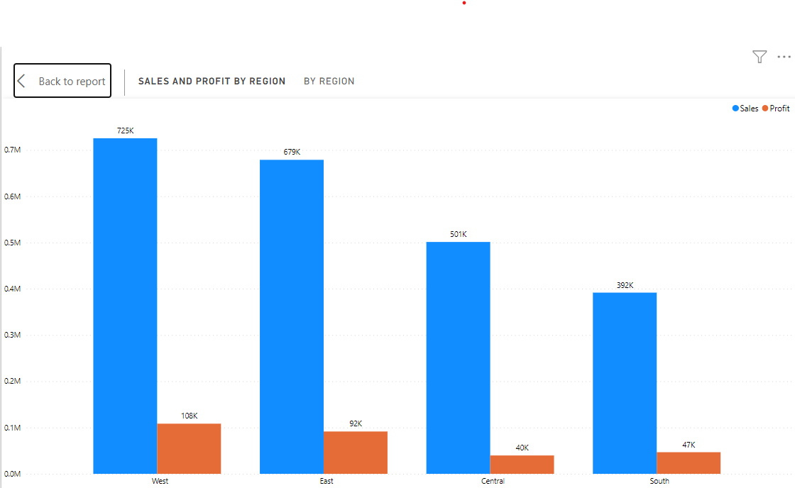
SALES AND PROFIT VS REGION

Slide 5
SALES AND PROFIT VS REGION- STORY
HIGHEST SALES REGION – WEST
HIGHEST SALES- 7,25,457.82
LOWEST SALES REGION - SOUTH
LOWEST SALES - 3,91,721.91
HIGHEST PROFITABLE REGION – WEST
HIGHEST PROFIT- 1,08,418.45
LOWEST PROFITABLE REGION - SOUTH
LOWEST PROFIT – 46,749.43
INSIGHTS:
WEST HAD THE HIGHEST SALES AND SOUTH HAD THE LOWEST SALES AND TOTAL PROFIT.﻿
SALES AND PROFIT DIVERGED THE MOST WHEN THE REGION WAS WEST.﻿
THE WEST REGION IS ALSO THE MOST PROFITABLE AND CONVERSELY, THE SOUTH REGION HAS THE LOWEST PROFIT

Slide 6
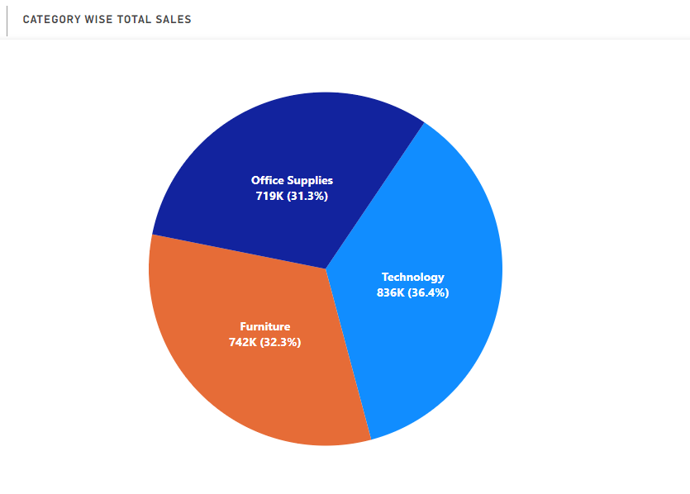
SALES VS CATEGORY

Slide 7
SALES VS CATEGORY
HIGHEST SALES CATEGORY - TECHNOLOGY SALES (8,36,154.03)
LOWEST SALES CATEGORY – OFFICE SUPPLIES SALES(7,19,047.03)
INSIGHTS:
TECHNOLOGY HAD THE HIGHEST SUM OF SALES AT 8,36,154.03, FOLLOWED BY FURNITURE AT 7,41,999.80 AND OFFICE SUPPLIES AT 7,19,047.03.
TECHNOLOGY HOLDS THE LARGEST SHARE OF SALES AT 36.40%, FOLLOWED CLOSELY BY FURNITURE AND OFFICE SUPPLIES.

Slide 8
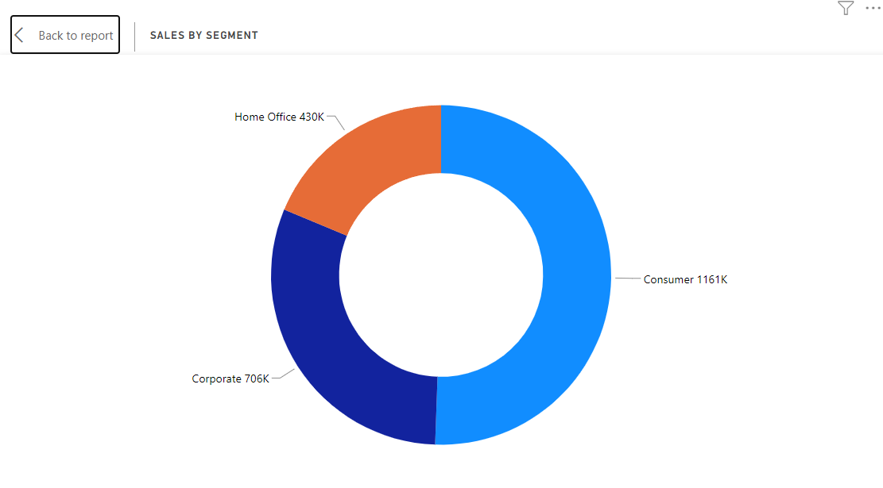
SALES VS SEGMENT

Slide 9
SALES VS SEGMENT
HIGHEST SALES SEGMENT - CONSUMER SALES (11,61,401.35)
LOWEST SALES SEGMENT –HOME OFFICE SALES(4,29,653.15)
INSIGHTS:
Consumer holds the largest share of sales at 50.56%, indicating a significant portion of your customer base.
Home Office, while lower in sales compared to the other segments, still makes a notable contribution.

Slide 10
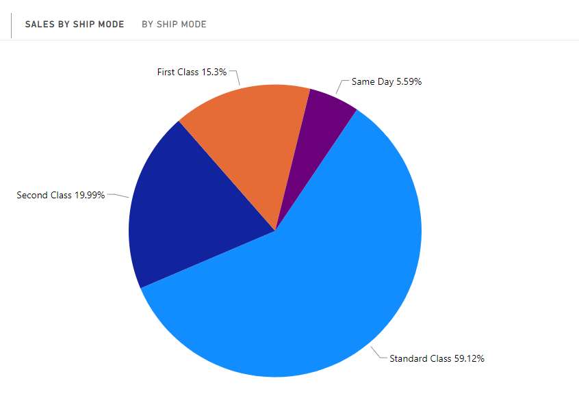
SALES VS SHIP MODE

Slide 11
SALES VS SHIP MODE
HIGHEST SALES SHIP MODE - STANDARD CLASS SALES (13,58,215.74)
LOWEST SALES SHIP MODE –SAME DAY SALES(128363.12)
INSIGHTS:
Standard Class Is The Dominant Ship Mode In Terms Of Sales, Contributing Significantly To The Total Sales.
Same Day, While Providing Quick Delivery, Has The Lowest Sales Compared To Other Ship Modes.
Optimizing And Promoting Standard Class Shipments May Be Beneficial For Increasing Overall Sales.

Slide 12
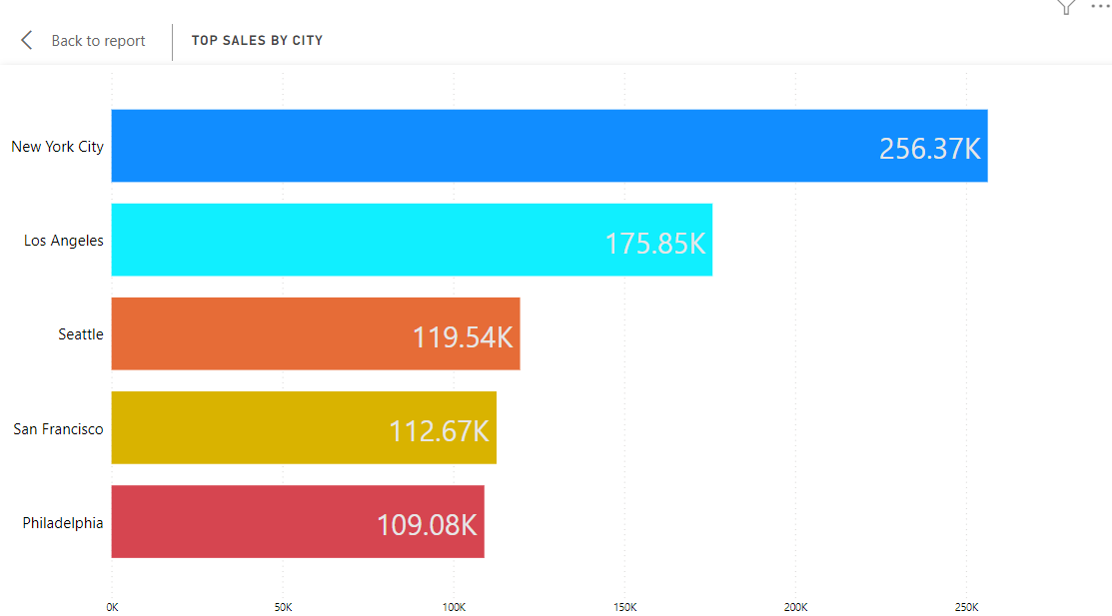
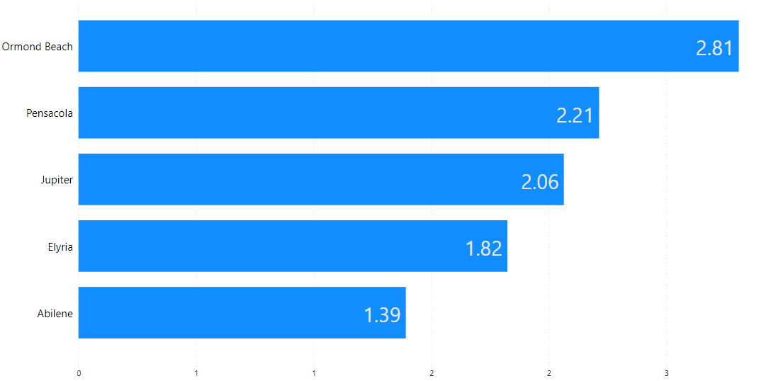
SALES VS CITY
TOP CITIES BY SALES
WORST CITIES BY SALES

Slide 13
SALES VS CITY
HIGHEST SALES CITY - NEW YORK CITY SALES (2,56,368.16)
LOWEST SALES CITY –ABILENE SALES(1.39)
INSIGHTS:
NEW YORK CITY ACCOUNTED FOR THE LARGEST SHARE OF SALES AT 11.16%
IN CONTRAST, ABILENE HAD THE LOWEST SALES, FACING CHALLENGES WITH JUST 1.39 IN SALES.
THE SALES DISTRIBUTION ACROSS ALL 531 CITIES VARIES WIDELY, HIGHLIGHTING THE DIVERSITY IN MARKET PERFORMANCE.

Slide 14
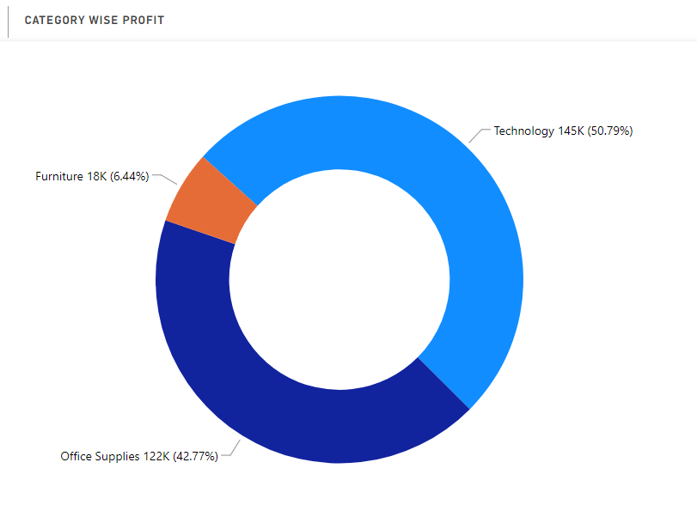
PROFIT VS CATEGORY
﻿Technology -1,45,454.95 Office Supplies -1,22,490.80 Furniture - 18,451.27

Slide 15
PROFIT VS CATEGORY
HIGHEST PROFITABLE CATEGORY - TECHNOLOGY PROFIT (1,45,454.95)
LOWEST PROFITABLE CATEGORY – FURNITURE PROFIT(18,451.27)
INSIGHTS:
TECHNOLOGY DOMINATES THE PROFIT LANDSCAPE WITH 50.79% OF THE TOTAL PROFIT.
OFFICE SUPPLIES ALSO PLAY A SIGNIFICANT ROLE IN PROFIT GENERATION, REPRESENTING A SUBSTANTIAL SHARE.
FURNITURE, ALTHOUGH PROFITABLE, HAS A RELATIVELY SMALLER IMPACT ON THE OVERALL PROFIT.

Slide 16
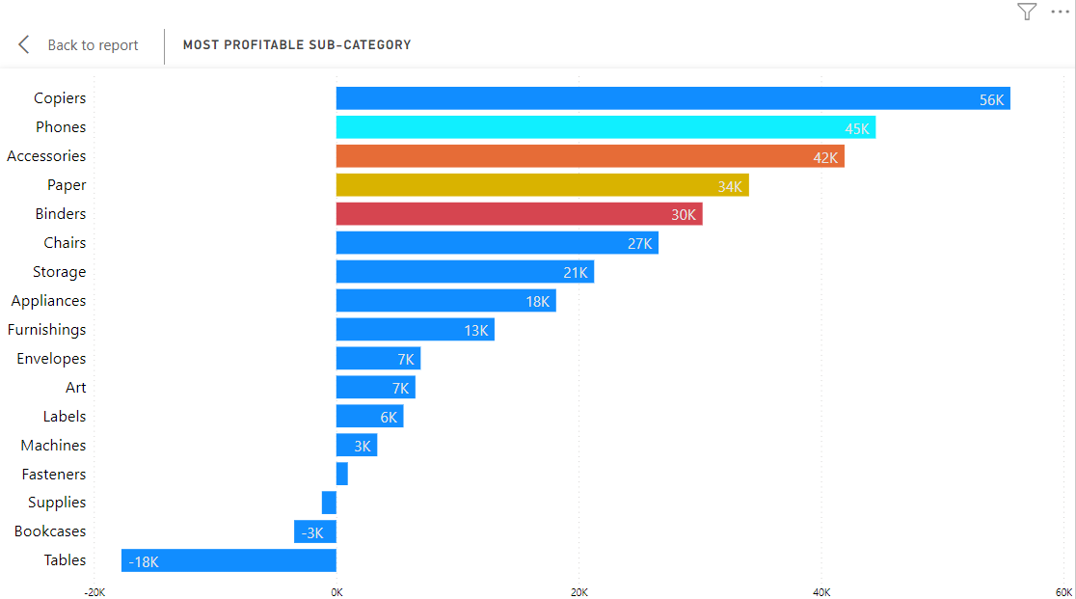
PROFIT VS SUB-CATEGORY

Slide 17
PROFIT VS SUB-CATEGORY
HIGHEST PROFITABLE SUB-CATEGORY - COPIERS PROFIT (55,617.82)
LOWEST PROFITABLE SUB-CATEGORY – TABLES PROFIT(-17,725.48)
INSIGHTS:
COPIERS STAND OUT AS THE MOST PROFITABLE SUB-CATEGORY, WITH A PROFIT OF $55,617.82.
TABLES, ON THE OTHER HAND, FACED A LOSS OF -$17,725.48
THE VAST DIFFERENCE IN PROFITABILITY BETWEEN COPIERS AND TABLES HIGHLIGHTS THE IMPORTANCE OF ANALYZING SUB-CATEGORY PERFORMANCE FOR MAKING STRATEGIC DECISIONS.

Slide 18
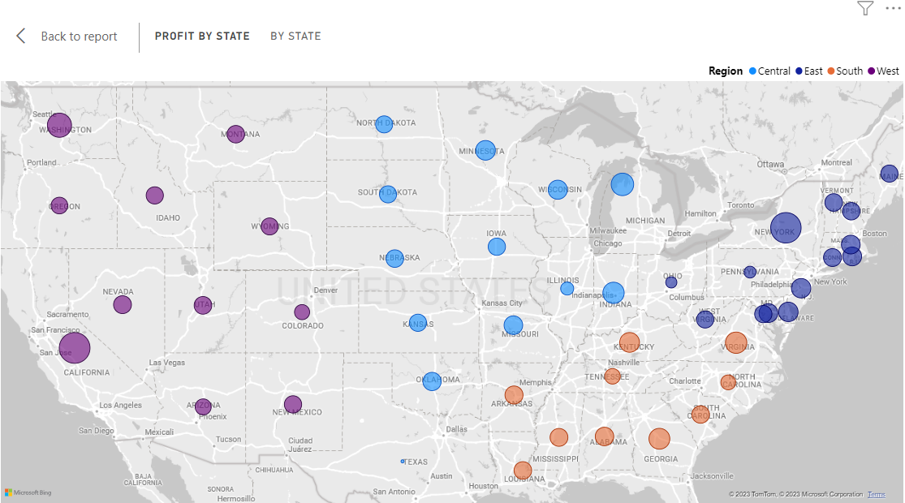
PROFIT VS STATES AND REGION

Slide 19
PROFIT VS STATE AND REGION
HIGHEST PROFITABLE STATE - CALIFORNIA PROFIT (76381.38)
LOWEST PROFITABLE STATE – TEXAS
PROFIT(-25729.79)
INSIGHTS:
CALIFORNIA IS OUR MOST PROFITABLE STATE, WITH A PROFIT OF 76,381.38.
UNFORTUNATELY, TEXAS IS OUR LEAST PROFITABLE STATE, WITH A LOSS OF -25,729.79.

Slide 20
CONCLUSION
SALES AND PROFIT VS REGION
HIGHEST SALES REGION – WEST
HIGHEST SALES- 7,25,457.82
LOWEST SALES REGION - SOUTH
LOWEST SALES - 3,91,721.91
HIGHEST PROFITABLE REGION – WEST
HIGHEST PROFIT- 1,08,418.45
LOWEST PROFITABLE REGION - SOUTH
LOWEST PROFIT – 46,749.43
SALES VS CATEGORY
HIGHEST SALES CATEGORY - TECHNOLOGY SALES (8,36,154.03)
LOWEST SALES CATEGORY – OFFICE SUPPLIES SALES(7,19,047.03)
SALES VS SEGMENT
HIGHEST SALES SEGMENT - CONSUMER SALES (11,61,401.35)
LOWEST SALES SEGMENT –HOME OFFICE SALES(4,29,653.15)

Slide 21
SALES VS SHIP MODE
HIGHEST SALES SHIP MODE - STANDARD CLASS SALES (13,58,215.74)
LOWEST SALES SHIP MODE –SAME DAY SALES(128363.12)
SALES VS CITY
HIGHEST SALES CITY - NEW YORK CITY SALES (2,56,368.16)
LOWEST SALES CITY – ABILENE SALES(1.39)
PROFIT VS CATEGORY
HIGHEST PROFITABLE CATEGORY - TECHNOLOGY PROFIT (1,45,454.95)
LOWEST PROFITABLE CATEGORY – FURNITURE PROFIT(18,451.27)

Slide 22
PROFIT VS SUB-CATEGORY
HIGHEST PROFITABLE SUB-CATEGORY - COPIERS PROFIT (55,617.82)
LOWEST PROFITABLE SUB-CATEGORY – TABLES PROFIT(-17,725.48)
PROFIT VS STATE AND REGION
HIGHEST PROFITABLE STATE - CALIFORNIA PROFIT (76381.38)
LOWEST PROFITABLE STATE – TEXAS
PROFIT(-25729.79)

Slide 23
INTERACTIVE DASHBOARD

Slide 24
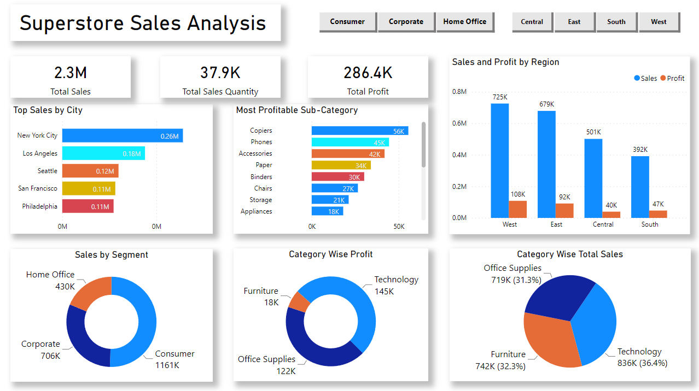

Slide 25
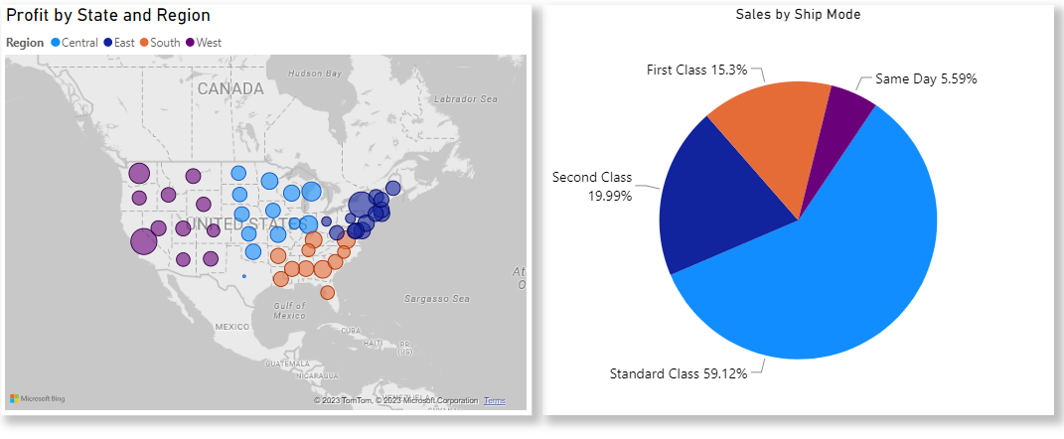

Slide 26
DATA SOURCE
DATA SET
https://drive.google.com/file/d/1lV7is1B566UQPYzzY8R2ZmOritTW299S/view
PROJECT SOURCE
https://github.com/Rahul9766/Superstore-Sales-Analysis-using-PowerBI.git

Slide 27
THANK YOU

